Slide 1
Body types prediction in OKCupid data
Machine Learning Fundamentals
Matej Bobnar
18th February 2019

Slide 2
Contents
Data & Questions
Data exploration and augmentation
Predictions
Conclusions

Slide 3
Data & questions
Numeric data: age, height, “income”.
Categorical data: body_type, diet, drinks, drugs, education, ethnicity, job, last_online, location, offspring, orientation, pets, religion, sex, sign, smokes, speaks, status.
10 Essays
Can we predict user‘s body type from his life habbits (diet, drinks, drugs, smoking) and his basic atributes (age, height, sex)?
Can we predict user‘s income from some numeric attributes (e.g. essays‘ length & age)?

Slide 4
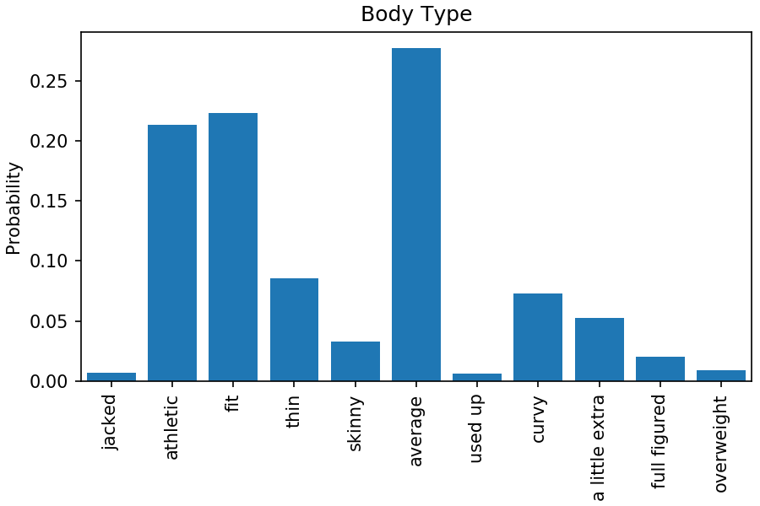
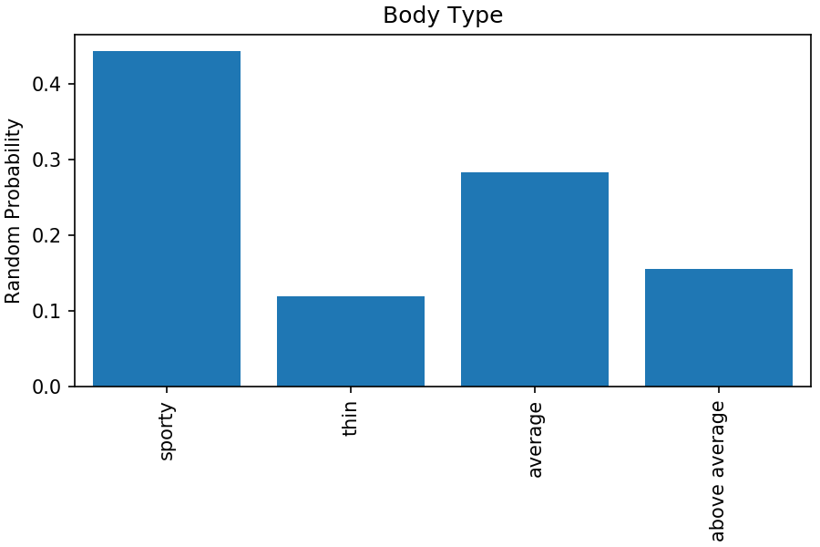
Data exploration & augmentation Body Type
Category | Code | Random prob. (%) | Join codes | Rand. Prob. (%)
Jacked | 0 | 0.7 | Sporty 0 | 44.4
Athletic | 1 | 21.3
Fit | 2 | 22.3
Thin | 3 | 8.6 | Thin 1 | 11.9
Skinny | 4 | 3.3
Average | 5 | 27.7 | Average 2 | 28.3
Used up | 6 | 0.6
Curvy | 7 | 7.2 | Above average 3 | 15.5
A little extra | 8 | 5.2
Ful figured | 9 | 2.0
Overweight | 10 | 0.9
Rather not say | NaN | N. a. | N. a. | N. a.

Slide 5
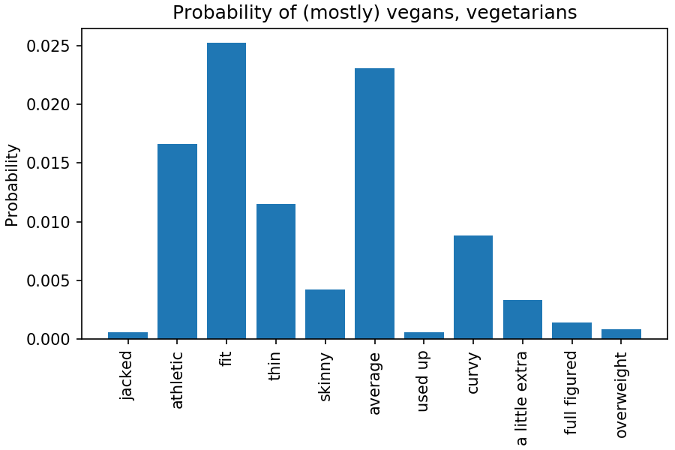
Data exploration & augmentation Diet type
Anything with „veg“ considered as vegan or vegetarian -> code 1
Everything else (including NaN) -> code 0

Slide 6
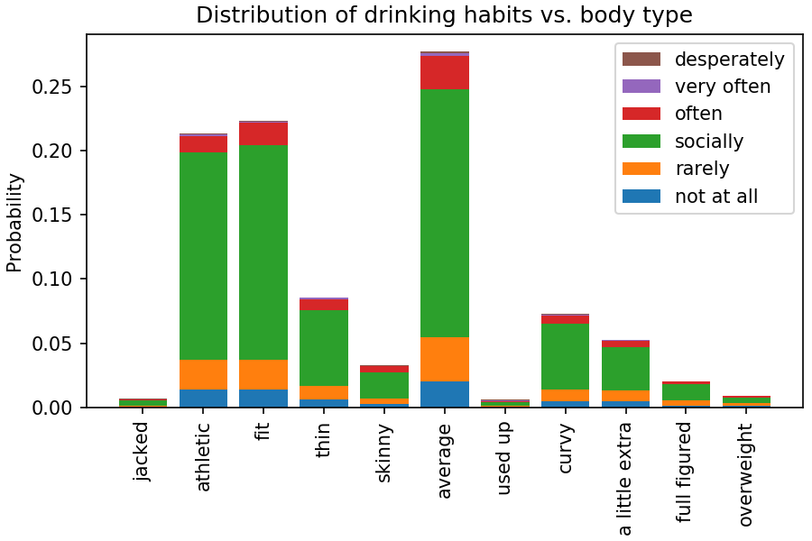
Data exploration & augmentation Drinking habbits
Drinking habbits | Code
Not at all | 0
Rarely | 1
Socially | 2
Often | 3
Very often | 4
Desperately | 5

Slide 7
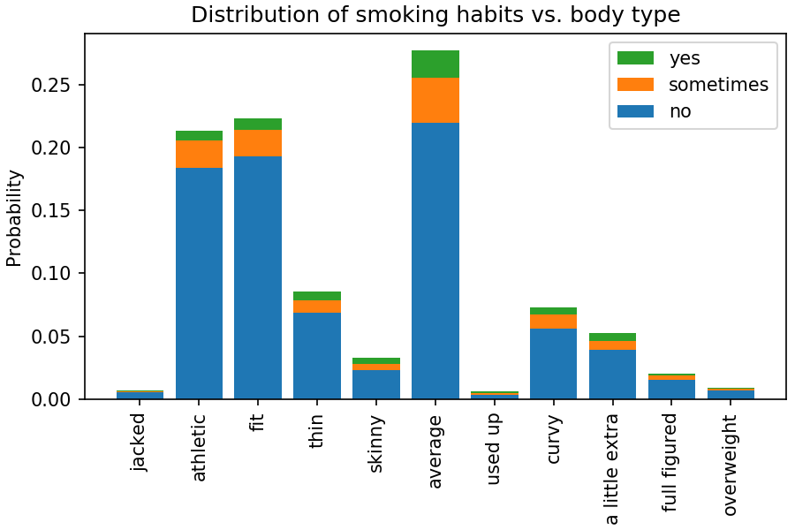
Data exploration & augmentation Smoking habbits
Smoking habbits | Code
No | 0
Sometimes | 1
Yes | 2

Slide 8
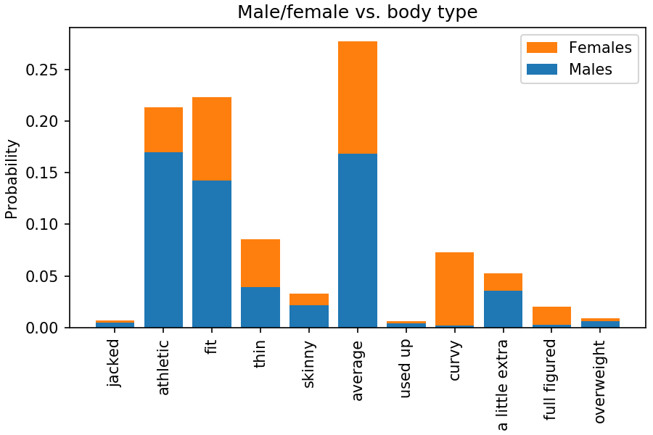
Data exploration & augmentation Sex distribution
Sex | Code | Total Prob. (%)
Male (m) | 0 | 59.8
Female (f) | 1 | 40.2

Slide 9
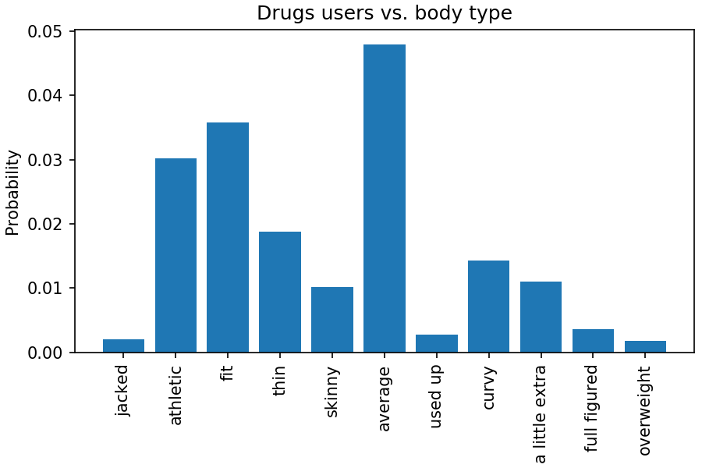

Data exploration & augmentation Drugs users
Drugs users | Code | Users (for plotting)
Never | 0 | 0
Sometimes | 1 | 1
Often | 2 | 1

Slide 10
Classification of 11 body types Support Vector Machine
Body Type | Random prob. (%) | SVC Precision (%)
Jacked | 0.7 | 0
Athletic | 21.3 | 32.7
Fit | 22.3 | 26.1
Thin | 8.6 | 20
Skinny | 3.3 | 12.5
Average | 27.7 | 29.7
Used up | 0.6 | 0
Curvy | 7.2 | 19.9
A little extra | 5.2 | 0
Full figured | 2.0 | 33.3
Overweight | 0.9 | 0
Gamma = 10, C = 5
Accuracy: 29.7 %
What does that mean?
What would random classification produce?
Improved results:
Better than guessing randomly!

Slide 11
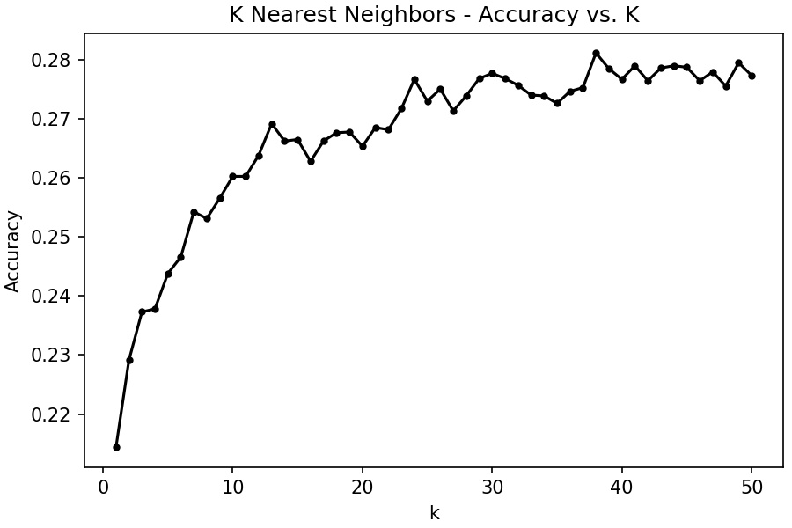
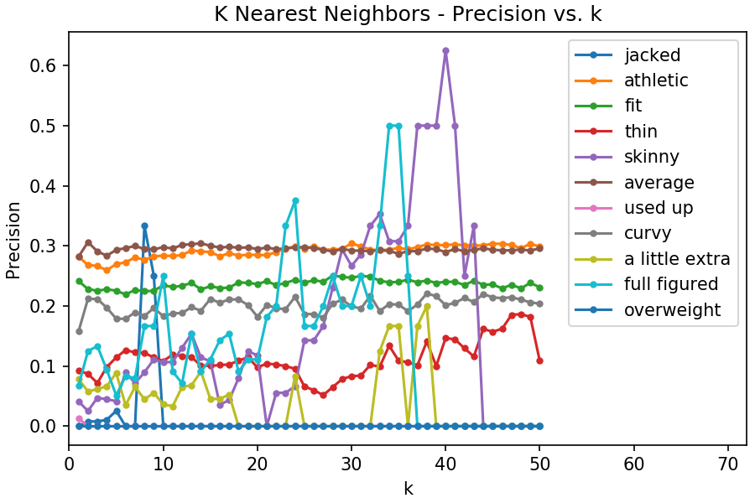
Classification of 11 body types K Nearest Neighbors
Accuracy approaching 28 %, not much better than random.

Slide 12
Classification of 4 body types Multinomial Naive Bayes
Body Type | Random prob. (%) | MNB Precision (%)
Sporty | 44.4 | 45.3
Thin | 11.9 | 0
Average | 28.3 | 35.6
Above average | 15.4 | 0
Will the simplified model improve predictions?
Accuracy: 44.1 %
Poor results still:
Only two categories found with precision not much above guessing randomly!

Slide 13
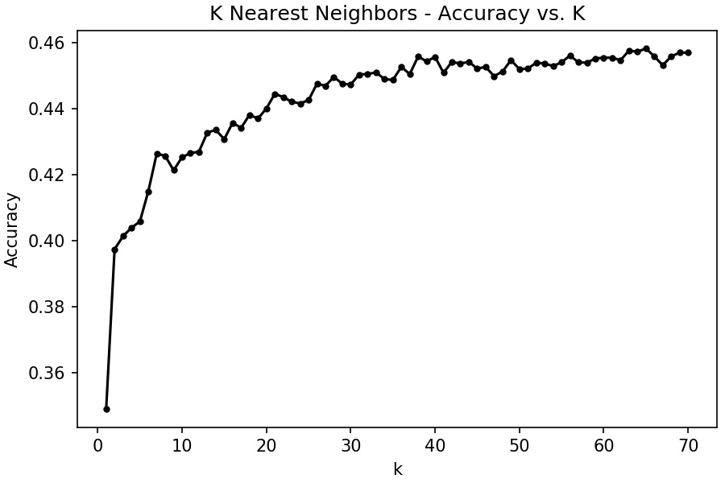
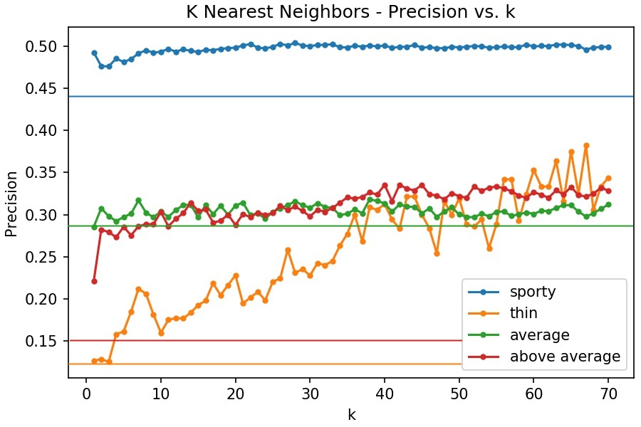
Classification of 4 body types K Nearest Neighbors
Accuracy approaching 46 %
Somewhat above random predictions, especially for thin & above average body type

Slide 14
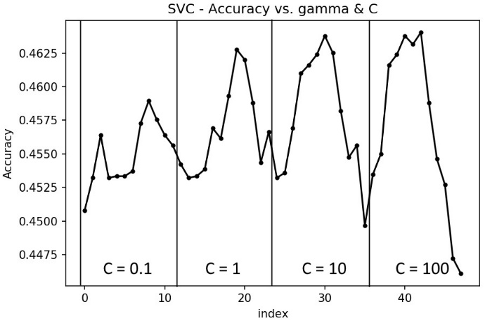
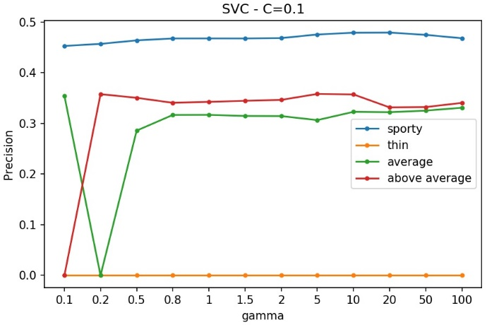
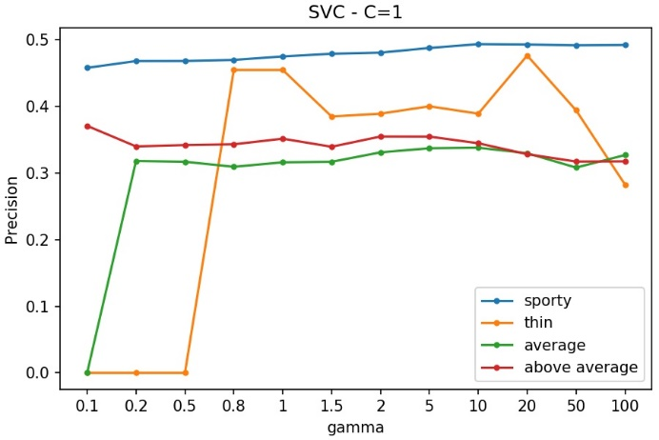
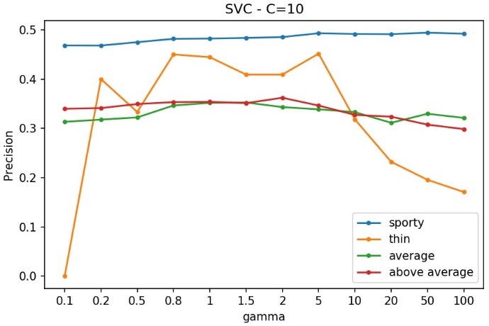
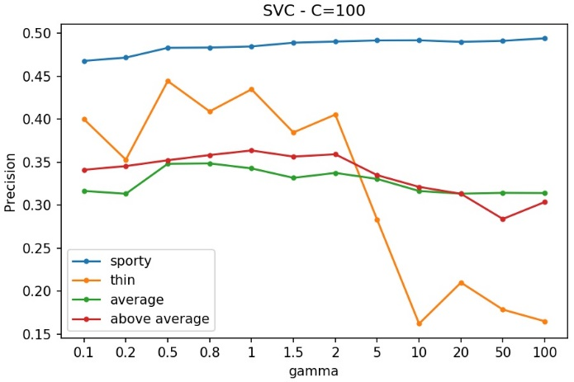
Classification of 4 body types Support Vector Machine
Results for gamma = 10 & C = 5:
Accuracy: 46.0 %
Body Type | Random prob. (%) | SVC Precision (%)
Sporty | 44.4 | 49.2
Thin | 11.9 | 40.0
Average | 28.3 | 34.0
Above average | 15.4 | 33.2

Slide 15
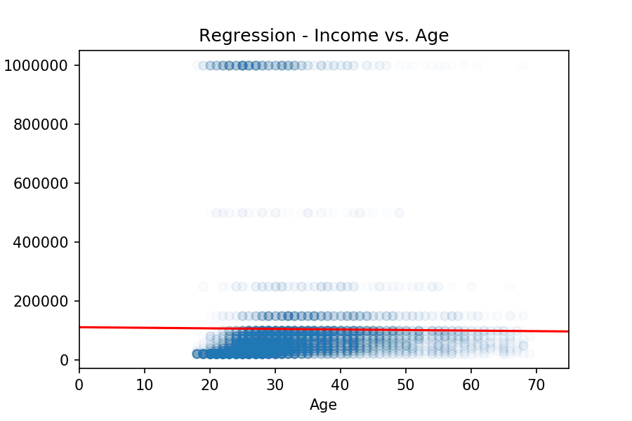
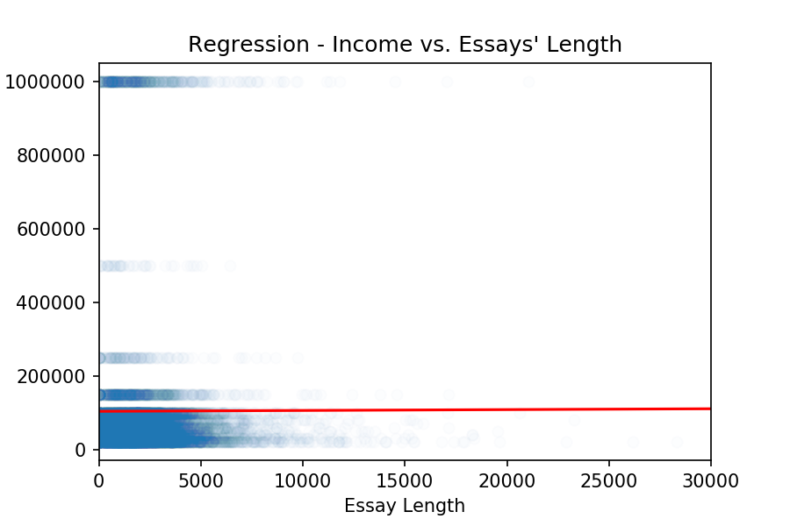
Income vs. Age & Essays‘ Length
Numeric data: income, age, essays‘ length
Income: replace -1 with NaN, delete all NaN raws
Age: no NaNs
Essays‘ Length: replace NaNs with empty strings, get total length of 10 essays
Regression on each: Income almost independent on Age or Essays‘ Length:
R² = 8e-5 R² = 7e-6
Multiple Linear Regression: R² = 9e-5

Slide 16
Conclusions
The reported body type of the peaple almost randomly dependent on their habbits and attributes
Simplification from 11 to 4 body types improves prediction
K Nearest Neighbors better than Naive Bayes, but…
Best predictions with Support Vector Machine, but also the most time consumming (several hours for parameters variation)
Possible improvements with different feature selection and further simplifications
Regression: Independence of income from either age or essays‘ length

